Slide 1



Welcome you all
Course: HTML
Day 3
M.Dhanalakshmi
Technical Trainer,
KG Micro College
KGiSL Campus, Coimbatore – 641 035.

Slide 2
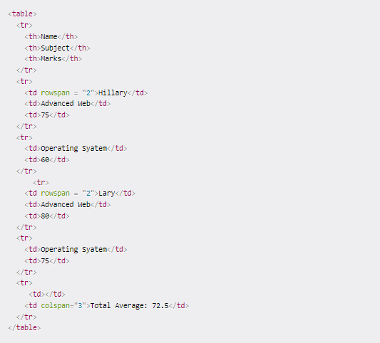
Table Recap

Slide 3

Comment Tag
You can add comments to your code that will not be seen by the browser, but only visible when viewing the code.
Comments can be used to:
- organize your code into sections
- 'comment out' large chunks of code to hide it from the browser.
Syntax: Comment tag
<!- - Comment multiple lines - - >

Slide 4
Form Tags
HTML Forms are required, when you want to collect some data from the site visitor.
For example, during user registration you would like to collect information such as name, email address, credit card, etc.
There are various form elements available like
text fields,
textarea fields,
drop-down menus,
radio buttons,
checkboxes, etc.

Slide 5
INPUT TYPES
The <input> tag specifies an input field where the user can enter data.
The <input> element is the most important form element.
The <input> element can be displayed in several ways, depending on the type attribute.
The different input types are as follows:
<input type="button">
<input type="checkbox">
<input type="color">
<input type="date">
<input type="datetime-local">
<input type="email">
<input type="file“>
<input type="month">
<input type="number">
<input type="password">
<input type="radio">
<input type="reset">
<input type="search">
<input type="submit">
<input type="tel">
<input type="text"> (default value)
<input type="time">
<input type="url">
<input type="week">

Slide 6
INPUT TYPE TEXT
The input type text is used to define a single-line text field.
The default width of the text field is 20 characters.
SYNTAX:
<input type=“text”>
INPUT TYPE TEXT AREA
The input type textarea defines a multi-line text input control.
It is used in a form to collect user inputs like comments or reviews.
A text space will hold an infinite range of characters.
The size of the text area is defined by <cols> and <rows>attribute.
The name attribute is needed for the reference in the form tag after the form is submitted.
By omitting the name attribute, data from the text area will not be submitted.
The id attribute is required to link the text area with a label.
SYNTAX:
<textarea>
</textarea>

Slide 7
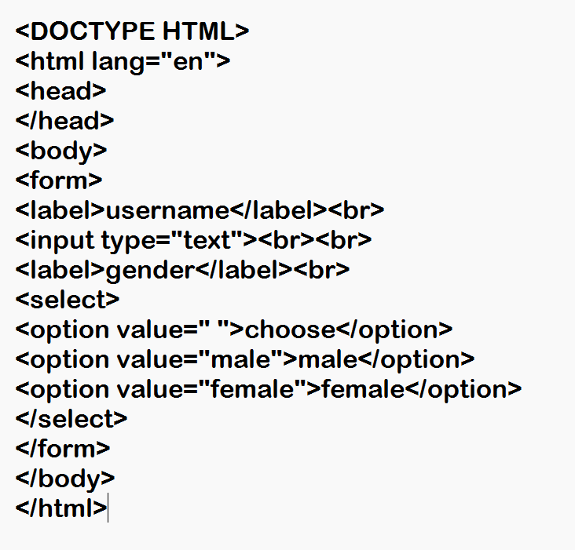
INPUT

Slide 8
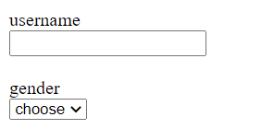
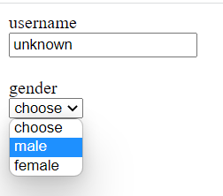
OUTPUT
1.
2.

Slide 9
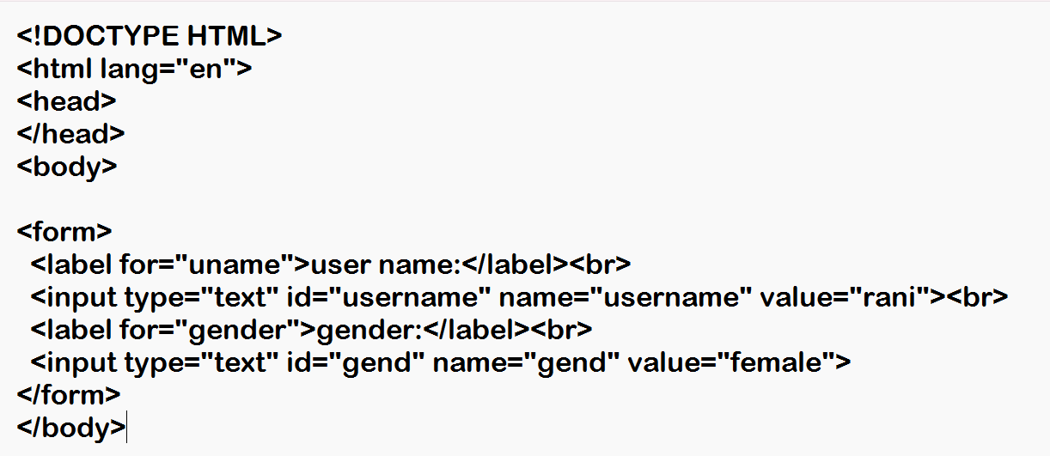
INPUT

Slide 10
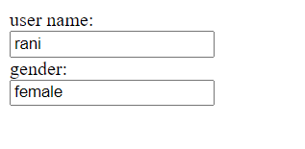
OUTPUT

Slide 11
INPUT TYPE BUTTON
It is used to define a clickable button in a document.
It is mostly used with the javascript to activate the script.It is used to submit the content.
Buttons can be styled using CSS.
There are various attributes that can be used with the “button” tag.Eg:autofocus,disabled,form,type,value,etc.
SYNTAX:
<input type=“button”>

Slide 12
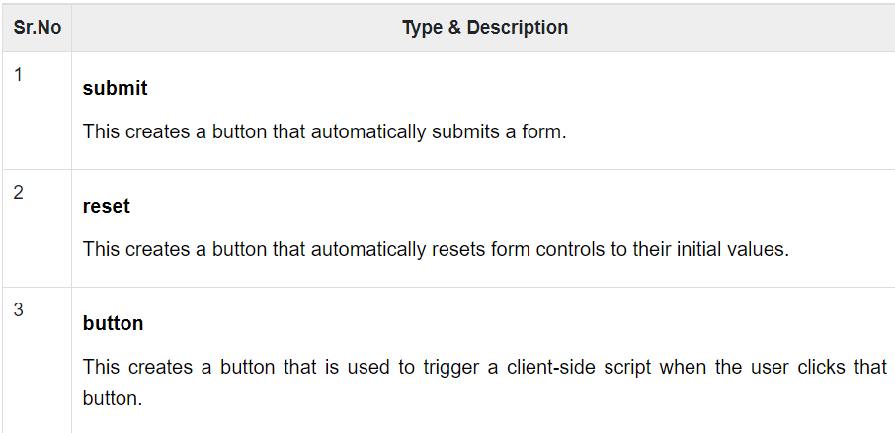
<button>
There are various ways in HTML to create clickable buttons. You can also create a clickable button using <input>tag by setting its type attribute to button. The type attribute can take the following values −

Slide 13
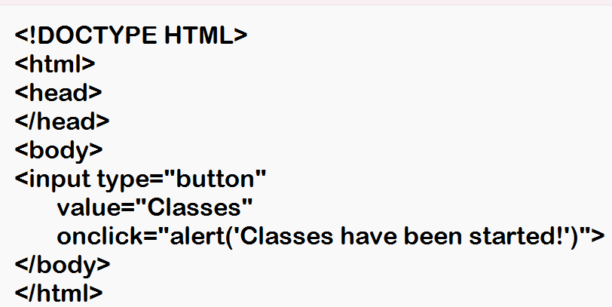
Input

Slide 14
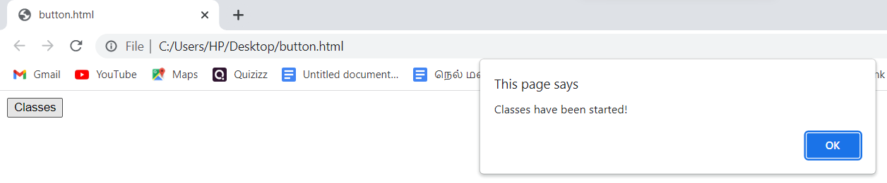
Output

Slide 15
<select>
The <select> element is used to create a drop-down list.
The <select> element is most often used in a form, to collect user input.
The name attribute is needed to reference the form data after the form is submitted (if you omit the name attribute, no data from the drop-down list will be submitted).
The id attribute is needed to associate the drop-down list with a label.
The <option> tags inside the <select> element define the available options in the drop-down list.

Slide 16
INPUT TYPE CHECK BOX
The Checkbox is used to define the square boxes.
It is a form element which allows users to select one or more options from the given options.
It is shown as a square box that is ticked (checked)when activated.
SYNTAX
<input type=“checkbox”>

Slide 17
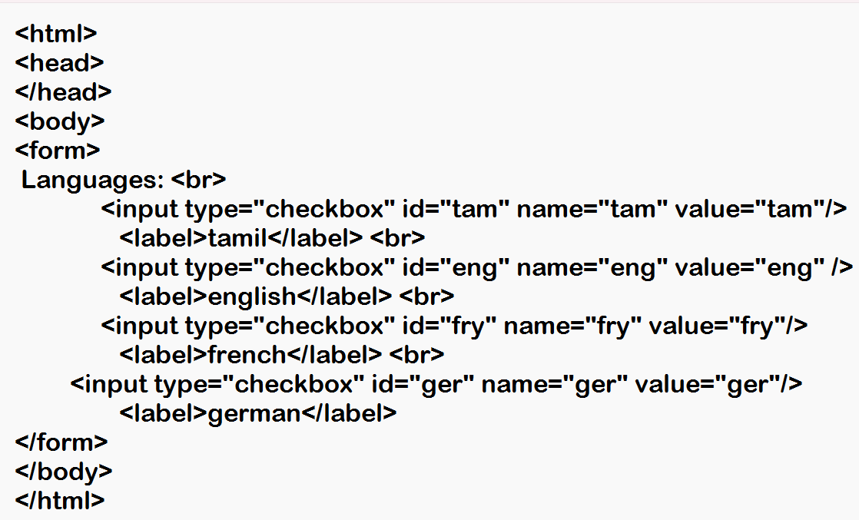
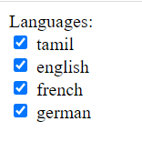
Input and output

Slide 18
INPUT TYPE DATE
The <input type="date"> tag creates an input field for a date (month, day, year).
Clicking the calendar icon inside the field will open a date picker.
The control's UI varies from browser to browser. Not all browsers support date.
The date field also accepts manual entry which follows a date format.
SYNTAX
<input type="date">

Slide 19
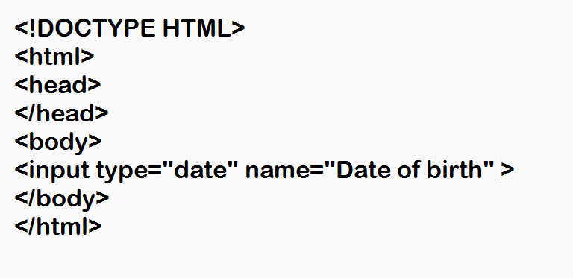
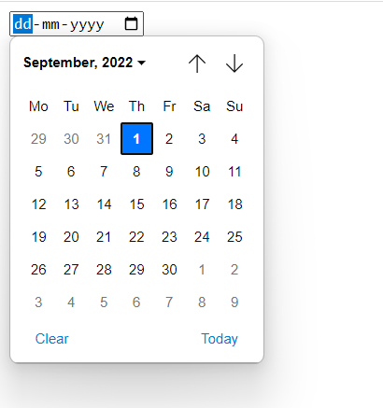
Input and output

Slide 20
INPUT TYPE DATETIME-LOCAL
The <input type="datetime-local"> tag creates an input field for date and time.
The -local suffix does not mean the time is local to the user, instead it is a time without a timezone.
The UI of this control varies from browser to browser. Browser support is limited.
A similarly named <input type="datetime"> is obsolete.
SYNTAX
<input type="datetime-local">

Slide 21
INPUT TYPE EMAIL
The <input type="email"> specifies an email input field.
When submitted, validation ensures that the input data is a valid email address.
The optional multiple attribute allows multiple, comma-separated, email addresses.
SYNTAX
<input type="email">

Slide 22
INPUT TYPE FILE
The <input type="file"> specifies a file selection control.
This element is rendered with a button and label, although in each browser it looks different.
The button opens a file selection dialog, and the label will display the selected filename(s).
Adding the multiple attribute will allow selecting multiple files in the dialog.
SYNTAX
<input type="file">

Slide 23
INPUT TYPE MONTH
The <input type="month"> specifies a month and year picker.
Clicking the calendar icon opens the month/year picker.
The UI of this control varies from browser to browser.
The month field also accepts manual entry which follows a month/year format.
SYNTAX
<input type="month">

Slide 24
INPUT TYPE PASSWORD
The <input type="password"> creates an input field for passwords.
Values entered are treated securely; they are masked and restricted in their use, for example, cannot copy.
The password masking character depends on the browser. It can be asterisk, dot, circle, and others.
SYNTAX
<input type="password">

Slide 25
INPUT TYPE RADIO
The <input type="radio"> creates a single radio button.
Radio buttons are grouped by name. All radio buttons with the same name belong to the same group.
Only a single radio button can be selected in a group by clicking on the circle button.
When a label is associated with a radio button, clicking the text will select that radio button.
The checked attribute selects a radio button. Only one in a group can have this attribute.
SYNTAX
<input type="radio">

Slide 26
INPUT TYPE RANGE
The <input type="range"> creates a range input control.
The default range is 0 to 100, but this can be changed with min and max attributes.
The step attribute is used to define the interval step between the values.
The range initial value is specified with the value attribute
SYNTAX
<input type="range">

Slide 27
INPUT TYPE SEARCH
The <input type="search"> creates a search input field.
Search fields are used to enter a query. Other than that, they function the same as text fields.
Depending on the browser, search fields may look a bit different from text fields.
SYNTAX
<input type="search">

Slide 28
INPUT TYPE SUMBIT
The <input type="submit"> specifies a submit button.
Clicking a submit button sends form data to a form handler specified by the action attribute on the form.
If the button's value is not set, it will be set default as Submit.
SYNTAX
<input type="submit“ value=“submit”>

Slide 29
INPUT TYPE TIME
The <input type="time"> creates an input field for time.
Clicking the clock icon inside the control opens the time picker.
The UI of this control varies from browser to browser.
The time field also accepts manual entry which follows a time format.
SYNTAX
<input type="time">

Slide 30
INPUT TYPE URL
The <input type="url"> creates a field that accepts a URL value.
This input field is validated when submitted. It only accepts null or a valid URL.
SYNTAX
<input type="url">

Slide 31
INPUT TYPE WEEK
The <input type="week"> creates an input field that accepts week and year data.
Clicking the calendar icon inside the field will open a week/year picker.
The control's UI varies from browser to browser. Browser support is spotty.
The week field also accepts manual entry which follows a week and year format.
SYNTAX
<input type="week">

Slide 32
INPUT TYPE RESET
The <input type="reset"> creates a reset button.
Clicking a reset button will reset all input elements in the form to their original value.
If the button's value is not set, it will be set default as Reset.
SYNTAX
<input type="reset">

Slide 33
INPUT TYPE NUMBER
The <input type="number"> specifies a number input.
A number input only accepts numberic values.
When focused the field shows a spinner that increases or decreases the value by a given step size.
The following attributes specify number input restrictions:
max - maximum value allowed
min - minimum value allowed
step - numeric interval size
value - initial value
SYNTAX
<input type="number">

Slide 34
INPUT TYPE PLACEHOLDER
The placeholder attribute specifies a short hint that describes the expected value of an input field (e.g. a sample value or a short description of the expected format).
The short hint is displayed in the input field before the user enters a value.
Value | Description
text | Specifies a short hint that describes the expected value of the input field
SYNTAX
<input placeholder="text">

Slide 35
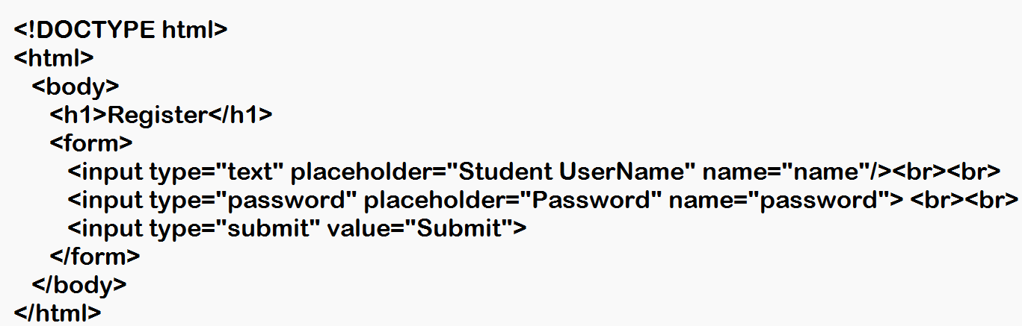
Input

Slide 36
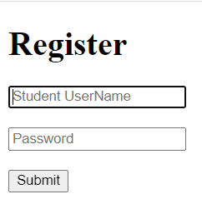
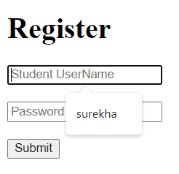
Output

Slide 37


Complete the
Week 3 Exercises
on Coursera

Slide 38



Thank You

